Slide 1
IOSharp: .NET Micro Framework on Linux
AUTHOR: Gerard Solé i Castellví
DIRECTOR: Juan López Rúbio
DEGREE: Bachelor in Telematics Engineering

Slide 2
Index
1. Introduction 3
2. IOSharp 6
3. AlterNative 13
4. Performance Test 19
5. Conclusions 21
6. Questions & Answers 23

Slide 3
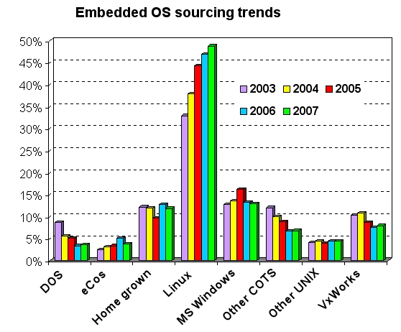
1. Introduction
Power increase from 8 to 32 bits on microprocessors
Cost reduction on hardware production
Increasing usage of Linux in embedded devices
Fig. 1: Linux growth between 2003 and 2007

Slide 4
1.2. Objectives
Deploy NETMF programs on Linux
Provide hardware support for embedded systems
Run HomeSense gateway on Raspberry Pi
Performance improvement
Provide Linux support for AlterNative
Develop missing libraries on the proprietary library
Evaluate the performance improvement

Slide 5
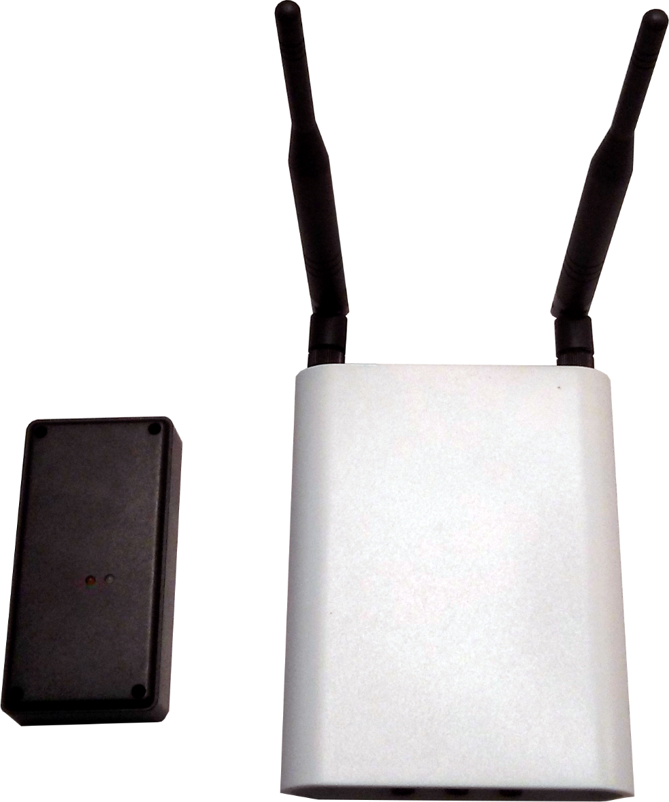
1.1. HomeSense devices
Fig. 2: HomeSense sensor on the left.
HomeSense gateway on the right

Slide 6
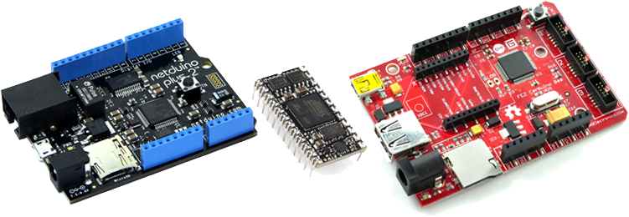
1.2. .NET Micro Framework
Virtual Machine running on the bare metal
Designed for resource-constrained devices
Multiple I/O Ports and Protocols
Fig. 3: Netudino Plus, Mini and FEZ Cerbuino. Arduino form factor

Slide 7
2. IOSharp
NETMF implementation on a High-Level basis
C# with Mono on Linux
C library for interfacing with communication protocols
Fig. 4: Original NETMF stack compared with IOSharp stack

Slide 8
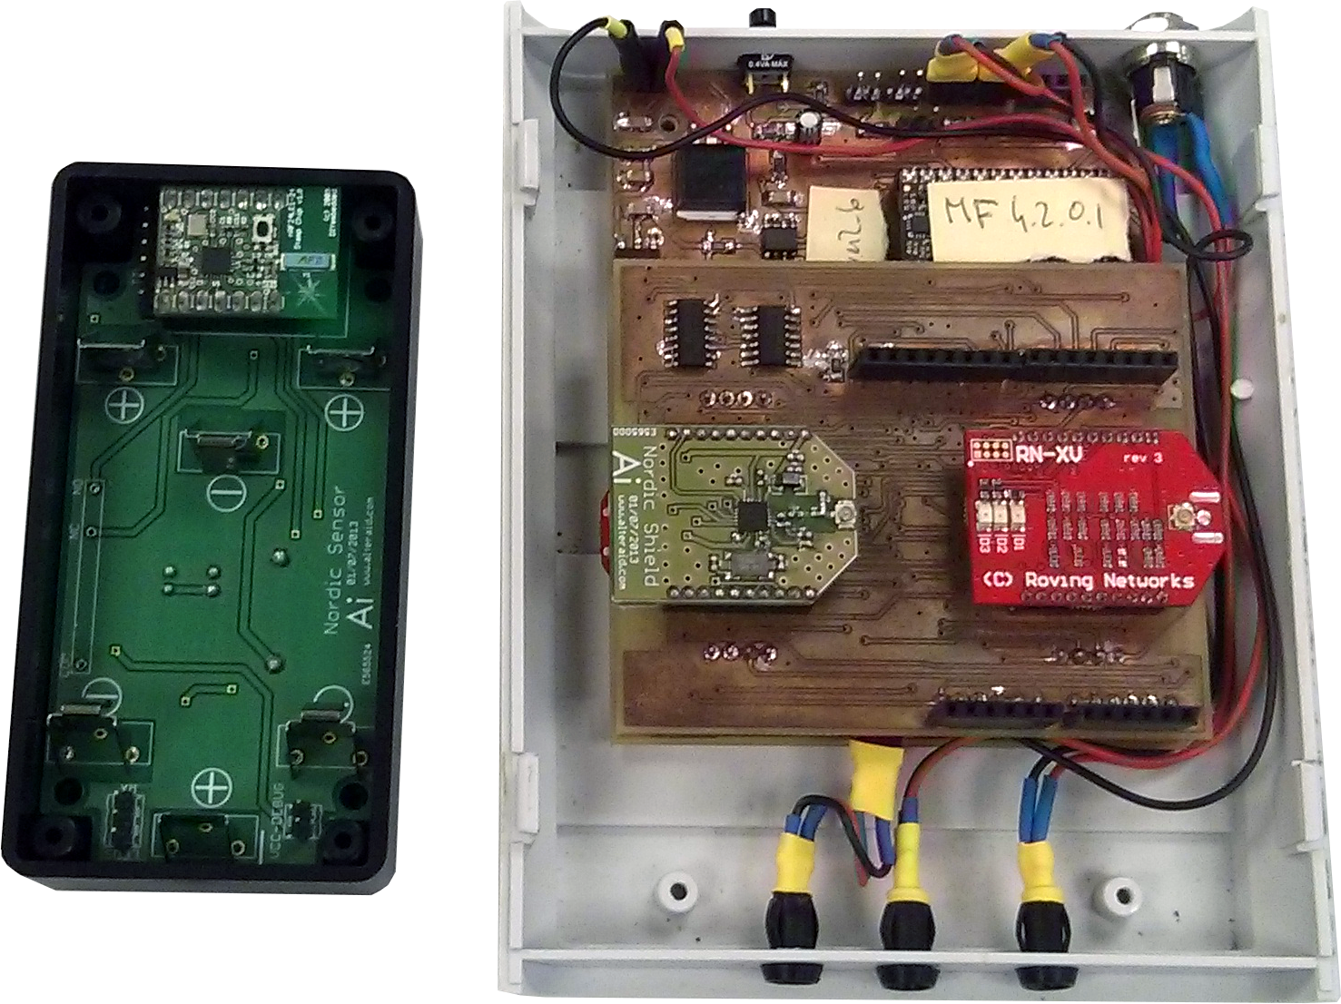
2.1. HomeSense Hardware
Fig. 4: HomeSense sensor and Gateway schema

Slide 9
2.2. GPIO
Used to read or write simple High or Low States on a Pin
I/O Ports are controlled and enabled or disabled through the file system
SYSFS → /sys/class/gpio/
Direction
State

Slide 10
2.3. Interrupts
Polling from a GPIO using the Poll function
P/Invokes are required for cross-language calls
Fig. 5: flow diagram for an Interrupt Port

Slide 11
2.4. SPI
Implemented using the provided Linux Kernel function
Included on IOSharp-C library
P/Invoked from C#
Fig. 6: Master-Slave SPI example

Slide 12
2.5. UART
NETMF and .NET Framework where compared
Same namespace → System.IO.Ports
Required methods for HomeSense in both implementations
Avoided a new reimplementation.
IOSharp relies on Mono Serial Port (UART)

Slide 13
2.6. HomeSense on Raspberry Pi
HomeSense proves that the GPIO, SPI, UART and Interrupts are working on the IOSharp implementation
First milestone is accomplished
Interruptions are slow on IOSharp. HomeSense in IOSharp don’t work as good as in NETMF

Slide 14
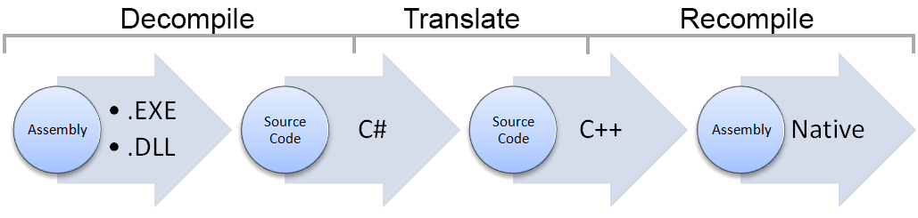
3. AlterNative
Source code translator written in C#
Translate a .NET Assembly to native C++
Use cases:
Performance
Cross-Platform development
Fig. 7: AlterNative translation process

Slide 15
3.1. Contributions
Make AlterNative compatible with Linux and MacOSX
Develop parts of the proprietary library
DateTime
TimeSpan
File
Encoding

Slide 16
3.2. Translation process
void Main(string[] args){
Console.WriteLine("Write a String"); string line = Console.ReadLine(); Console.WriteLine("Read line: " + line); byte[] b = new byte[2]; b[0] = 0; b[1] = 255; Console.WriteLine(Encoding.UTF8.GetString(b));
}
void Main(String args[]){
Console::WriteLine(new String("Write a String")); String* line = Console::ReadLine(); Console::WriteLine(new String("Read line: ") + line); Array<char>* b = new Array<char>(2); b->SetData(0, 0); b->SetData(1, 255); Console::WriteLine(Encoding::UTF8->GetString(b));
}

Slide 17
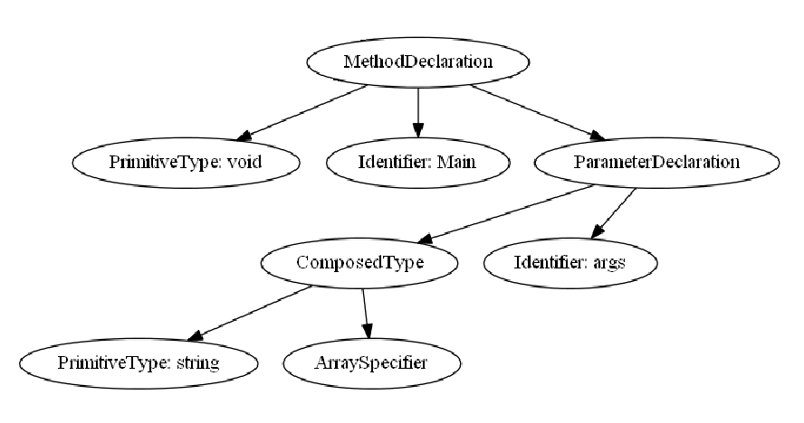
3.3. Translation process II
Composed Identifier
Fig. 8: AST conversions from C# to C++
void Main(string[] args){}
void Main(string args[]){}

Slide 18
3.4. IOSharp C++
IOSharp is translated using AlterNative
AlterNative System Library replaces Mono runtime
Fig. 11: NETMF, IOSharp and IOSharp C++ Stacks

Slide 19
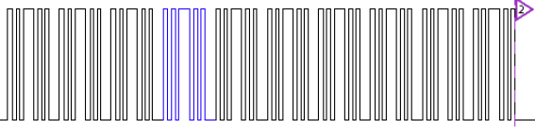
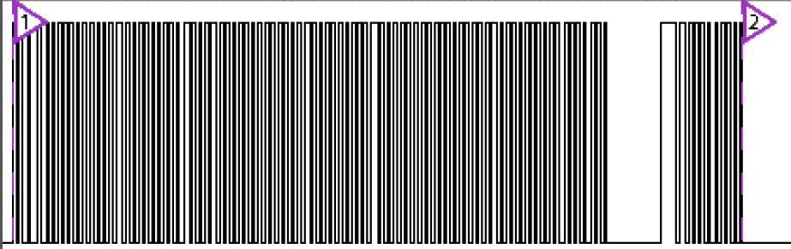
4. Performance Test
Fig. 10: GPIO changes on Mono with C#
Fig. 11: GPIO changes on C++
Fig. 12: Time comparison between Mono and C++ in 10K iterations of an Output Port

Slide 20
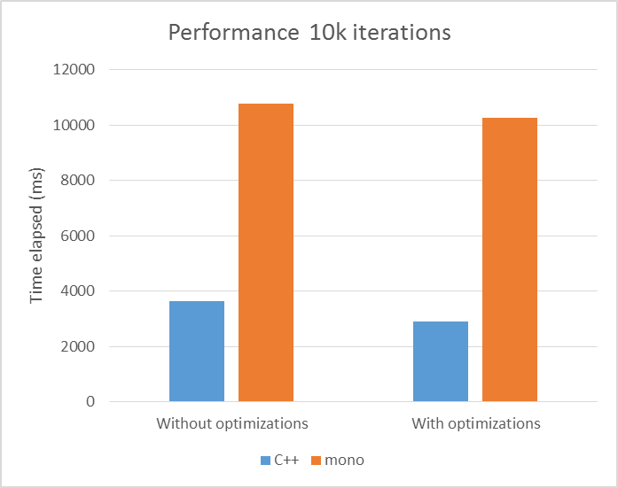
4.1. Results
Evaluate the increased performance using AlterNative
Fig. 13: Graph showing the speedup of the C++ version in front of the Mono one. 62% of gain.

Slide 21
5. Conclusions
Deploy NETMF programs on Linux
Provide hardware support for embedded systems:
GPIO, Interrupts, SPI and UART
Run HomeSense gateway on Raspberry Pi
Performance improvement
Provide Linux support for AlterNative:
Runs on Linux and Mac
Develop missing libraries on the proprietary library
DateTime, TimeSpan, File, Encoding
Evaluate the performance improvement

Slide 22
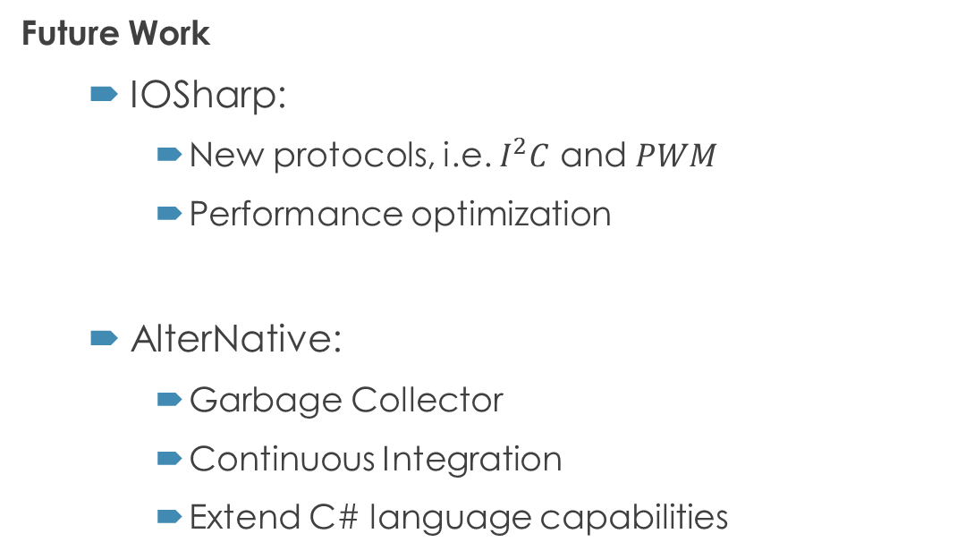
5. Conclusions II
Future Work
IOSharp:
New protocols, i.e. $I^{2}C$ and $PWM$
Performance optimization
AlterNative:
Garbage Collector
Continuous Integration
Extend C# language capabilities

Slide 23

5. Conclusions III
The work developed in this project contributes to the work described in the paper:
“AlterNative: A cross-platform tool for translating from high-level code to native code”
Download IOSharp library at
https://github.com/GerardSoleCa/IOSharp-netmf-Linux

Slide 24
6. Questions & Answers
Questions are guaranteed in life – Answers aren’t

